Slide 1
Higher Biology
Structure of DNA
Mr G R Davidson

Slide 2
Structure of DNA
Chromosomes are made up of chains of molecules, called genes.
A gene is a unit of heredity and is composed of a complex substance called Deoxyribonucleic acid (DNA).

Slide 3
Structure of DNA
The DNA molecule can be described as a double helix.
It is made up of two strands of sub-units called nucleotides.
Each nucleotide has 3 parts:
deoxyribose sugar
a base
phosphate
P
Deoxy-ribose sugar
Base

Slide 4
Structure of DNA
The deoxyribose molecule has 5 carbon atoms and they are numbered in a clockwise direction starting with the oxygen molecule.
The phosphate molecule is joined to the deoxyribose at the ⁵C.
The base is joined at the ¹C.
P
⁵C
O
⁴C
¹C
³C
²C

Slide 5
Structure of DNA
There are four different nucleotides, because there are four different bases.
The four bases are:
Cytosine
Guanine
Adenine
Thymine
P
Deoxy-ribose
Cytosine
P
Deoxy-ribose
Guanine
P
Deoxy-ribose
Adenine
P
Deoxy-ribose
Thymine

Slide 6
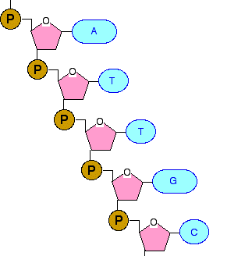
Structure of DNA
A strong chemical bond is formed between the phosphate of one nucleotide and the ³C of the deoxyribose of the next nucleotide.
This creates the backbone of the DNA molecule.
⁵C
³C

Slide 7
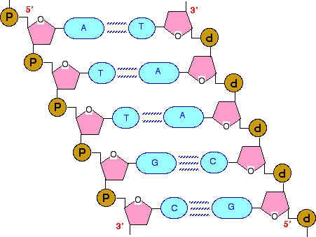
Structure of DNA
The opposite strand of the DNA molecule appears to be upside down and the 2 strands are joined by weak hydrogen bonds.
Adenine always pairs with thymine.
Cytosine always pairs with guanine.

Slide 8
Structure of DNA
Because the 2 strands run in opposite directions, we say they are anti-parallel.
This means that one strand has a ⁵C at the top and the ³C at the bottom while the other is the opposite.
The strand can only grow by adding to the ³C end.

Slide 9
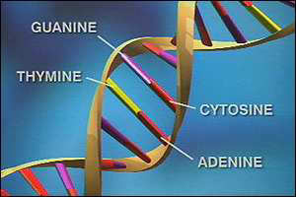
Structure of DNA

Slide 10
Structure of DNA
Although DNA is a double strand, it can be linear or circular, depending on which type of cell it is found in.
Prokaryotes (bacteria) have circular DNA.
Some of this DNA can be separate from the main circular chromosome in smaller rings called plasmids.

Slide 11
Structure of DNA
Eukaryotes (cells with a nucleus and other organelles enclosed in a membrane) have linear DNA.
Some of the eukaryotic cell’s DNA is found not in the nucleus, but in organelles such as the mitochondria or chloroplasts.

Slide 12
Structure of DNA
Prokaryote | Eukaryote
Bacteria | Animals, green plants & fungi
No nucleus | Nucleus
Circular DNA | Linear DNA
Plasmids present in many bacteria | Plasmids absent from animal & plant cells, but present in some fungi such as yeast
No chloroplasts | Present in green plants
No mitochondria | Mitochondria

Slide 13
Structure of DNA
Due to a DNA strand being extremely long, it must be organised so that it can unwind instead of being a tangled mess.
This is achieved by the DNA being tightly coiled around protein bundles.
DNA
Protein
Bundle

Slide 14
Structure of DNA
Each associated protein bundle has the DNA wrapped around it twice to create a kind of ‘beaded necklace’.
This means the DNA can then unwind again when it needs to replicate.
It also explains how approximately 2 metres of DNA fits inside the nucleus of a cell.

